Slide 1







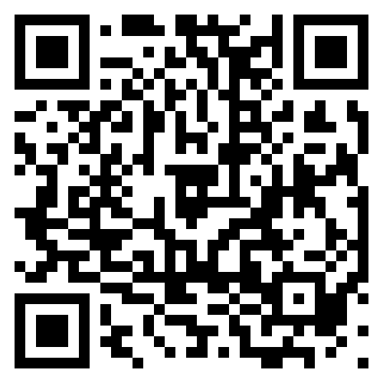













Crestmead State School
SHARE TEAMKIDS WITH YOUR SCHOOL FAMILIES AND
LET THE FUN BEGIN!
PLEASE DISPLAY OUR TEAMKIDS CONTACTS
on your school’s website and via your parent communications.
Please add the TeamKids logo and one of the promotional
banners above to your school’s website, so families can easily find us. Download logo & banners HERE
info@teamkids.com.au
teamkids.com.au
1300 035 000
TEAMKIDS LOGO AND WEBSITE BANNERS
The link below directs families to your school’s
dedicated TEAMKIDS VENUE PAGE,
making it quick and easy to register and book.
YOUR TEAMKIDS
PARTNERSHIP MANAGER
Tamika Byatt
Tamika.b@teamkids.com.au
0427 163 404
Insert school’s URL venue page HERE
SAMPLE COPY “ABOUT TEAMKIDS” FOR YOUR WEBSITE
HOW TO REGISTER
& BOOK AT TEAMKIDS FLYER
Please copy the below onto your school’s website
so families know what to expect at TeamKids:
Display this informative flyer
on your school’s website to help families prepare
for their first day
at TeamKids.
Download flyer & QR code HERE
TEAMKIDS - BEFORE, AFTER + HOLIDAY CARE
TeamKids supports families and adds value every day through child‑centered programs that excite, engage and enrich children’s lives.
INCLUSIONS:
Engaging Educators
Yummy Snacks
Inclusive Clubs
School Holiday FUN
Epic Termly Events
Play Zones & Games
Screen FREE Fun!
Find out more, REGISTER & BOOK via teamkids.com.au
DIGITAL DISPLAY
TK FLAG
DID YOU KNOW?
80%
TEAMKIDS SIGNAGE AROUND YOUR SCHOOL
OF SCHOOL FAMILIES
first hear about TeamKids via school signage and school communications. Please help us spread the word!
ASSORTED
MARKETING
POSTERS
FENCE BANNER
METAL FENCE SIGN
BAV MKTG KIT
/teamkidsaustralia

